Slide 1
Descripciónes físicas (Physical Descriptions)
Srta. Rymal

Slide 2
How to explain…
To say someone or something is, you use the word
Es
Example: Alejandro es listo.
(Alejandro is smart.)
To say that you are something you use the word
soy
Example: Soy listo.
(I am smart. Use lista for girls.)

Slide 3
grande
pequeño (a)

Slide 4
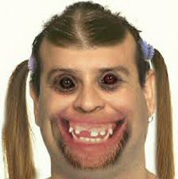
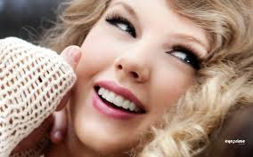
bonito (a)
feo (a)

Slide 5
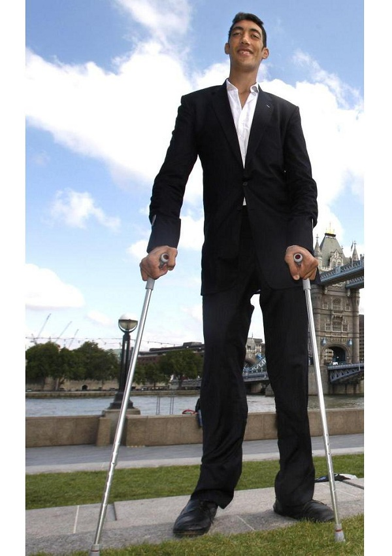
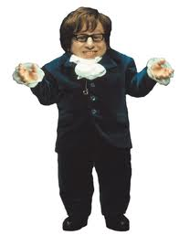
alto (a)
bajo (a)

Slide 6
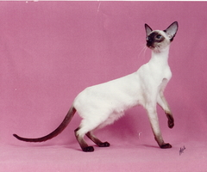
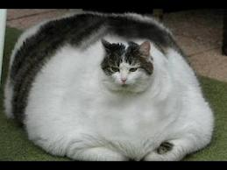
flaco (a)
gordo (a)

Slide 7
pelo
(hair)

Slide 8
How to explain…
To say someone or something has , you use the word
tiene
Example: Jorge tiene pelo rojo.
(Jorge has red hair..)
To say that you have something you use the word
tengo
Example: Tengo pelo rojo.
(I am a redhead..)

Slide 9
***Note: when you talk about hair, which ends in o, you never make the color end in a, even if you are a girl.
The exception is when you are calling someone (or yourself) a brunette, blonde, redhead etcetera. It’s the same as in English. You would use soy for I am or es for he or she is, and then the word.

Slide 10
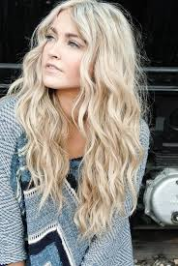
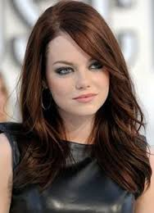
castaño (a)
rubio (a)

Slide 11
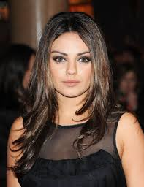
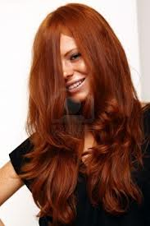
pelirojo (a)
moreno (a)

